Slide 1


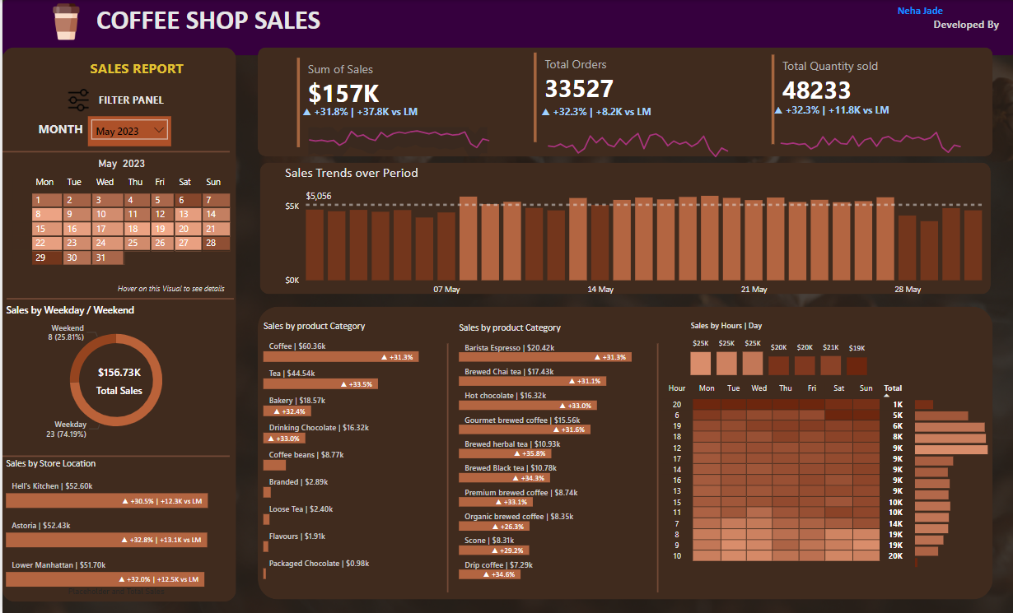
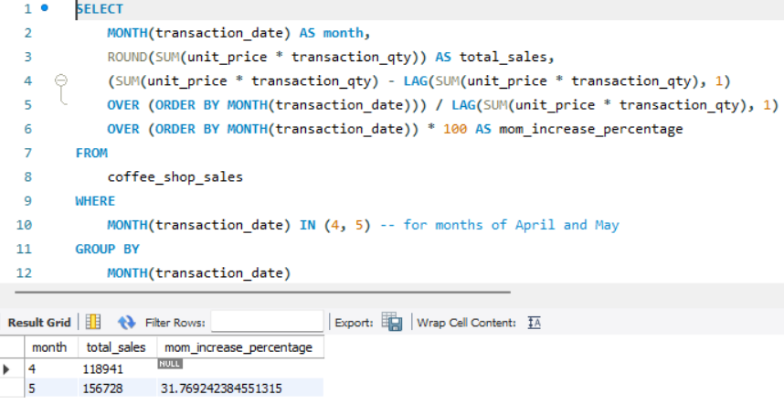
COFFEE SHOP SALES
POWER BI + SQL

Slide 2
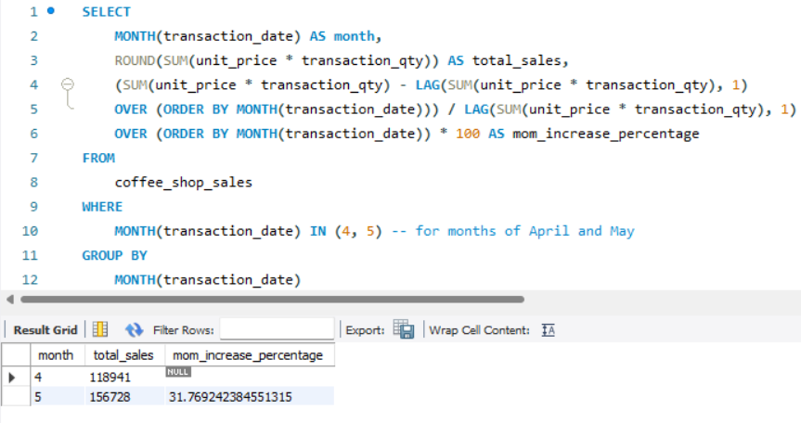

My SQL
Firing SQL Quires To Solve The Business Problems

Slide 3
Problem Statement
1. The objective is to analyze sales data through detailed and interactive visualizations. The focus is to uncover patterns, trends, and insights that help in understanding sales performance across various dimensions such as time (daily, weekday vs. weekend), store locations, product categories, and top-performing products.
2. Analyze sales data to uncover patterns and trends across time, locations, and product categories for improved performance insights.
Chart Requirements:
Calendar Heat Map: Daily sales visualization with dynamic month selection.
Weekday vs. Weekend Sales: Compare sales performance.
Location Analysis: MoM sales trends by store location.
Daily Sales Line Chart: Highlight sales above/below average.
Category Analysis: Sales contribution by product categories.
Top Products: Display top 10 products by sales.
Day & Hour Heat Map: Analyze sales patterns with detailed metrics.

Slide 4
Task Completed
Data Walkthrough
Raw Data file preparation
Creating Database
Importing File
Cleaning imported File
Changing Data Types
Firing SQL Queries for Business Requirements

Slide 5

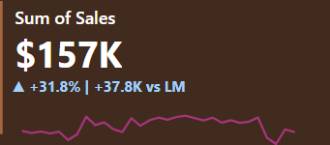
Total Sales KPI
SELECT
ROUND(SUM(unit_price * transaction_qty)) as Total_Sales FROM
coffee_shop_sales
WHERE
MONTH(transaction_date) = 5
-- for month of (CM-May)

Slide 6


TOTAL SALES KPI - MOM DIFFERENCE AND MOM GROWTH
SELECT
MONTH(transaction_date) AS month,
ROUND(SUM(unit_price * transaction_qty)) AS total_sales,
(SUM(unit_price * transaction_qty) - LAG(SUM(unit_price * transaction_qty), 1)
OVER
(ORDER BY MONTH(transaction_date))) / LAG(SUM(unit_price * transaction_qty), 1)
OVER
(ORDER BY MONTH(transaction_date)) * 100 AS mom_increase_percentage
FROM coffee_shop_sales
WHERE
MONTH(transaction_date) IN (4, 5) -- for months of April and May
GROUP BY
MONTH(transaction_date)
ORDER BY
MONTH(transaction_date);

Slide 7

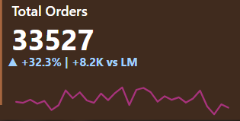
TOTAL ORDERS
SELECT
COUNT(transaction_id) as Total_Orders
FROM
coffee_shop_sales
WHERE
MONTH (transaction_date)= 5 -- for month of (CM-May)

Slide 8


TOTAL ORDERS KPI - MOM DIFFERENCE AND MOM GROWTH
SELECT
MONTH(transaction_date) AS month, ROUND(COUNT(transaction_id)) AS total_orders,
(COUNT(transaction_id) - LAG(COUNT(transaction_id), 1)
OVER (ORDER BY MONTH(transaction_date)))
/ LAG(COUNT(transaction_id), 1) OVER (ORDER BY MONTH(transaction_date)) * 100AS mom_increase_percentage
FROM
coffee_shop_sales
WHERE
MONTH(transaction_date) IN (4, 5) -- for April and May
GROUP BY
MONTH(transaction_date)
ORDER BY
MONTH(transaction_date);

Slide 9

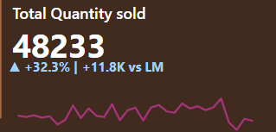
TOTAL QUANTITY SOLD
SELECT
SUM(transaction_qty) as Total_Quantity_Sold
FROM coffee_shop_sales
WHERE
MONTH(transaction_date) = 5 -- for month of (CM-May)

Slide 10


TOTAL QUANTITY SOLD KPI MOM DIFFERENCE AND MOM GROWTH
SELECT
MONTH(transaction_date) AS month,
ROUND(SUM(transaction_qty))
AS total_quantity_sold,
(SUM(transaction_qty) - LAG(SUM(transaction_qty), 1)
OVER (ORDER BY MONTH(transaction_date))) /
LAG(SUM(transaction_qty), 1)
OVER (ORDER BY MONTH(transaction_date)) * 100
AS mom_increase_percentage
FROM coffee_shop_sales
WHERE
MONTH(transaction_date) IN (4, 5) -- for April and May
GROUP BY
MONTH(transaction_date)
ORDER BY
MONTH(transaction_date);

Slide 11

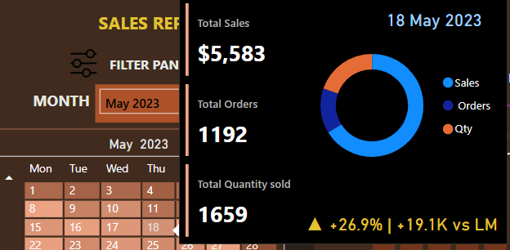
CALENDAR TABLE – DAILY SALES, QUANTITY and TOTAL ORDERS
SELECT
SUM(unit_price * transaction_qty) AS total_sales,
SUM(transaction_qty) AS total_quantity_sold,
COUNT(transaction_id) AS
FROM coffee_shop_sales
WHERE transaction_date = '2023-05-18'; --For 18 May 2023

Slide 12

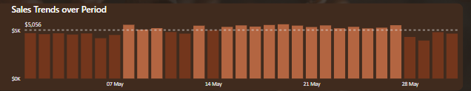
SALES TREND OVER PERIOD
SELECT
AVG(total_sales) AS average_sales
FROM (
SELECT
SUM(unit_price * transaction_qty) AS total_sales
FROM coffee_shop_sales
WHERE
MONTH(transaction_date) = 5 -- Filter for May
GROUP BY transaction_date
) AS internal_query;

Slide 13
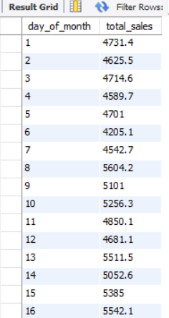
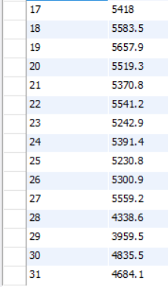
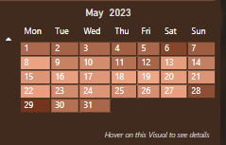
DAILY SALES FOR MONTH SELECTED
SELECT
DAY(transaction_date) AS day_of_month,
ROUND(SUM(unit_price * transaction_qty),1) AS total_sales
FROM coffee_shop_sales
WHERE
MONTH(transaction_date) = 5 -- Filter for May
GROUP BY
DAY(transaction_date)
ORDER BY
DAY(transaction_date);

Slide 14
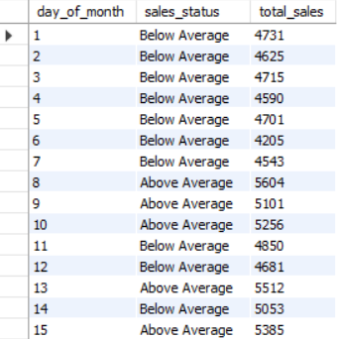
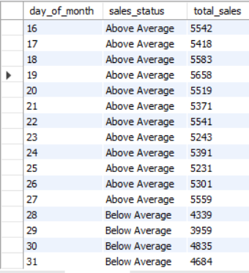
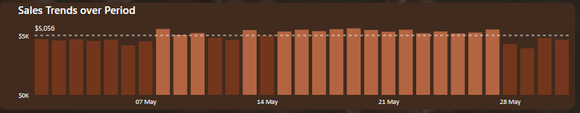
Daily Sales vs. Average: Above or Below
SELECT day_of_month,
CASE
WHEN total_sales > avg_sales THEN 'Above Average'
WHEN total_sales < avg_sales THEN 'Below Average'
ELSE 'Average'
END AS sales_status, total_sales
FROM (
SELECT
DAY(transaction_date) AS day_of_month,
SUM(unit_price * transaction_qty) AS total_sales,
AVG(SUM(unit_price * transaction_qty)) OVER () AS avg_sales
FROM coffee_shop_sales
WHERE
MONTH(transaction_date) = 5 -- Filter for May
GROUP BY
DAY(transaction_date)
AS BY day_sales_data
ORDER of_month;

Slide 15
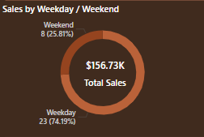

SALES BY WEEKDAY / WEEKEND:
SELECT
CASE
WHEN DAYOFWEEK(transaction_date) IN (1, 7) THEN 'Weekends'
ELSE 'Weekdays'
END AS day_type, ROUND(SUM(unit_price * transaction_qty),2) AS total_sales
FROM coffee_shop_sales
WHERE
MONTH(transaction_date) = 5 -- Filter for May
GROUP BY
CASE
WHEN DAYOFWEEK(transaction_date) IN (1, 7) THEN 'Weekends'
ELSE 'Weekdays'
END;

Slide 16

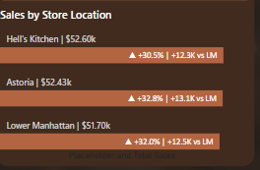
SALES BY STORE LOCATION
SELECT store_location,
SUM(unit_price * transaction_qty) as Total_Sales
FROM coffee_shop_sales
WHERE
MONTH(transaction_date) =5
GROUP BY store_location
ORDER BY
SUM(unit_price * transaction_qty) DESC

Slide 17
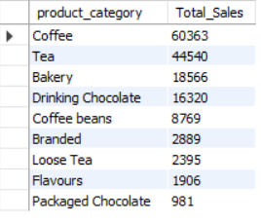
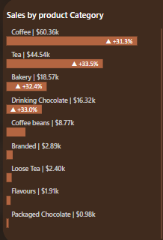
SALES BY PRODUCT CATEGORY
SELECT product_category, ROUND(SUM(unit_price * transaction_qty),1) as Total_Sales
FROM coffee_shop_sales
WHERE
MONTH(transaction_date) = 5
GROUP BY product_category
ORDER BY
SUM(unit_price * transaction_qty) DESC

Slide 18
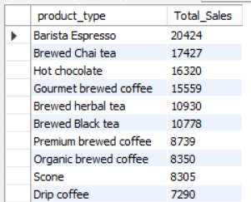
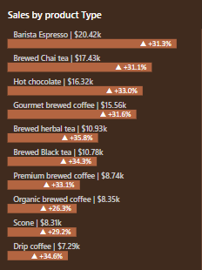
SALES BY PRODUCTS (TOP 10)
SELECT product_type,
ROUND(SUM(unit_price * transaction_qty),1) as Total_Sales
FROM coffee_shop_sales
WHERE
MONTH(transaction_date) = 5
GROUP BY product_type
ORDER BY
SUM(unit_price * transaction_qty) DESC
LIMIT 10

Slide 19
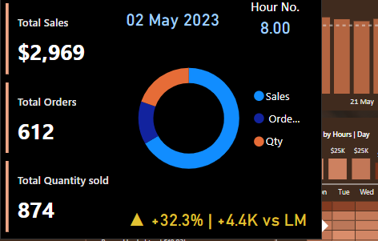

SALES BY DAY | HOUR
SELECT
ROUND(SUM(unit_price * transaction_qty)) AS Total_Sales,
SUM(transaction_qty) AS Total_Quantity,
COUNT(*) AS Total_Orders
FROM coffee_shop_sales
WHERE
DAYOFWEEK(transaction_date) = 3 -- Filter for Tuesday (1 is Sunday, 2 is Monday, ..., 7 is Saturday)
AND HOUR(transaction_time) = 8 -- Filter for hour number 8
AND MONTH(transaction_date) = 5 -- Filter for May (month number 5)

Slide 20
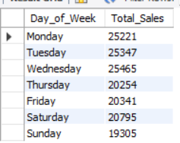
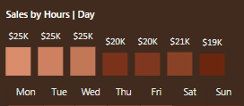
TO GET SALES FROM MONDAY TO SUNDAY FOR MONTH OF MAY
SELECT
CASE
WHEN DAYOFWEEK(transaction_date) = 2 THEN 'Monday'
WHEN DAYOFWEEK(transaction_date) = 3 THEN 'Tuesday'
WHEN DAYOFWEEK(transaction_date) = 4 THEN 'Wednesday'
WHEN DAYOFWEEK(transaction_date) = 5 THEN 'Thursday'
WHEN DAYOFWEEK(transaction_date) = 6 THEN 'Friday'
WHEN DAYOFWEEK(transaction_date) = 7 THEN 'Saturday'
ELSE 'Sunday'
END AS Day_of_Week,
ROUND(SUM(unit_price * transaction_qty)) AS Total_Sales
FROM coffee_shop_sales
WHERE
MONTH(transaction_date) = 5 -- Filter for May (month number 5)
GROUP BY
CASE
WHEN DAYOFWEEK(transaction_date) = 2 THEN 'Monday'
WHEN DAYOFWEEK(transaction_date) = 3 THEN 'Tuesday'
WHEN DAYOFWEEK(transaction_date) = 4 THEN 'Wednesday'
WHEN DAYOFWEEK(transaction_date) = 5 THEN 'Thursday'
WHEN DAYOFWEEK(transaction_date) = 6 THEN 'Friday'
WHEN DAYOFWEEK(transaction_date) = 7 THEN 'Saturday'
ELSE 'Sunday'
END;

Slide 21
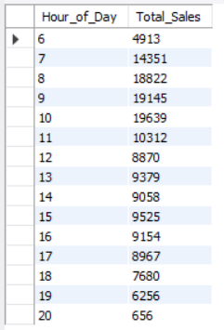
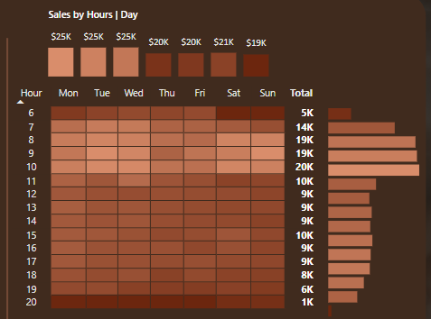
TO GET SALES FOR ALL HOURS FOR MONTH OF MAY
SELECT
HOUR(transaction_time) AS Hour_of_Day,
ROUND(SUM(unit_price * transaction_qty))
AS Total_Sales
FROM coffee_shop_sales
WHERE
MONTH(transaction_date) = 5
-- Filter for May (month number 5)
GROUP BY
HOUR(transaction_time)
ORDER BY
HOUR(transaction_time);

Slide 22
Insights
Overall Sales Performance:
Total sales for May 2023: $157K, which represents a 31.8% increase compared to last month.
Both total orders (33,527) and total quantity sold (48,233) show a 32.3% improvement vs. last month, indicating strong growth.
Top Performing Product Categories:
Coffee contributes the most sales at $60.36K, followed by Tea ($44.54K), with both showing a significant increase (+31.9% and +33.5%).
Bakery and Drinking Chocolate also show impressive growth (both over +30%).
Product Type Trends:
Barista Espresso ($20.42K) and Brewed Chai Tea ($17.43K) lead among individual product types.
Hot Chocolate ($16.32K) and Premium brewed coffee ($8.74K) also exhibit strong performance.
Sales by Weekday/Weekend:
Majority of sales occurred on weekdays (74.19%), suggesting weekday-focused customer engagement.
Store Location Analysis:
Hell’s Kitchen ($52.60K) is the top-performing store, showing a 30.5% sales growth compared to last month.
Astoria and Lower Manhattan also performed well, with growth exceeding 32%.
Sales by Hour/Day:
Peak sales hours occur in the morning and early afternoon (9 AM–2 PM), which aligns with typical coffee and snack purchase times.
Sales are consistent throughout the week, with slightly lower activity on Sundays.
Sales Trends:
Daily sales average around $5,056, with no drastic fluctuations but minor dips on weekends.

Slide 23
Recommendation
Focus on High-Performing Products:
Increase promotion of top products like Coffee, Tea, Barista Espresso, and Hot Chocolate through discounts, bundles, or loyalty programs to maintain momentum.
Introduce seasonal or limited-time offers in the Bakery category to boost sales further.
Boost Weekend Sales:
Develop weekend-specific promotions (e.g., "Weekend Happy Hours" or special combos) to drive more traffic during this slower period.
Partner with local events to attract customers on weekends.
Optimize Store Operations:
Hell’s Kitchen is a strong performer, but other locations like Astoria and Lower Manhattan show equally promising growth. Consider replicating successful strategies from Hell’s Kitchen in these areas.
Staff peak hours (7AM– 12 PM) with additional resources to handle high demand efficiently.
Targeted Marketing Campaigns:
Since weekdays drive most sales, focus digital advertising and email campaigns during those days.
Utilize customer insights (from loyalty programs or surveys) to tailor product recommendations and upsell strategies.
Introduce Evening Offerings:
With lower sales during evening hours, consider introducing special evening-themed beverages or snacks, such as herbal teas, desserts, or discounted coffee.
Refine Data Analysis:
Drill down into customer preferences by combining product sales with customer demographics.
Analyze specific reasons for the Sunday sales dip and target this day with a unique promotion (e.g., family discounts or kids’ menus).

Slide 24
Thank you

